Slide 1
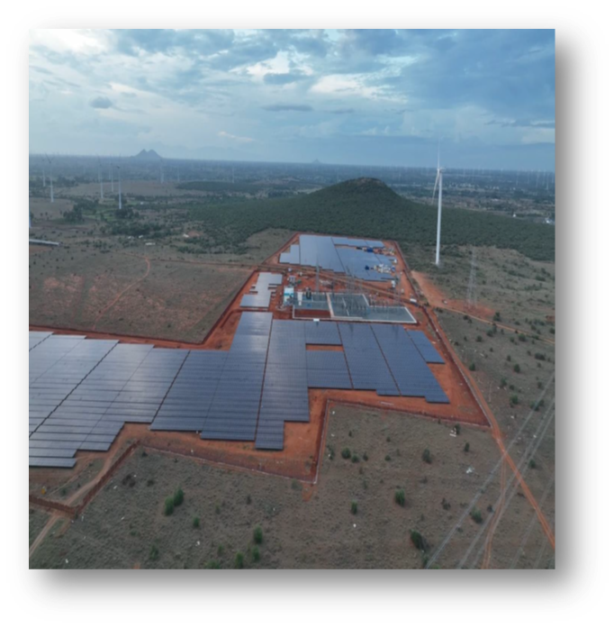
asset Overview Nellai board meeting September 2025

Slide 2
Agenda
Safety KPI- Nellai – Health, Safety and Security Summary
Operations Performance Overview.
2.a. Nellai Performance Snapshot for 2025
2.b. Nellai Performance snap from 2022 to 2024
Maintenance Performance Overview.
3.a. Plant availability.
3.b. Maintenance Activities.
3.c. Breakdown Insights.
Status of additional works
Action plan for Implementation of Nellai Improvement Observations & NRPL Site Observations Status
NRPL Site Observation Glimpse

Slide 3
Agenda
Safety KPI- Nellai – Health, Safety and Security Summary
Operations Performance Overview.
2.a. Nellai Performance Snapshot for 2025
2.b. Nellai Performance snap from 2022 to 2024
Maintenance Performance Overview.
3.a. Plant availability.
3.b. Maintenance Activities.
3.c. Breakdown Insights.
Status of additional works
Action plan for Implementation of Nellai Improvement Observations & NRPL Site Observations Status
NRPL Site Observation Glimpse

Slide 4

1. Safety KPI- Nellai – Health, Safety and Security Summary
For information
In Aug 25, all HSS key performance Indicator are fulfilling the SKI requirements, more over since Commercial operation day (25th May 2022) we do not have any accident or incident with loss of time, totalizing 316510 Man-hours.
KPI | Target | Sum of Q1 (Jan-Mar) | Sum of Q2 (Apr-Jun) | Jul 25 | Aug 25 | Yearly Average Jan-Aug 2025
Serious injury rate (SI) | 0 | 0 | 0 | 0 | 0 | 0
High potential observations (HIPO) | 0 | 0 | 0 | 0 | 0 | 0
Total Recordable Injury rate (TRI) | 0 | 0 | 0 | 0 | 0 | 0
Environment Incidents (EI) | 0 | 0 | 0 | 0 | 0 | 0
Total Engagement (E) | 10 | 15.8 | 21.5 | 17.3 | 15.1 | 17.8
Safe Manhours | Total Manpower O&M | Safe Manhours since COD*
 | 33 | 316510
Target
July’25
Aug’25
Q1 25
Q2 25
2025 Year
Avg
(Jan-Aug)
Note: *.- Include projects (i.e., cable to bus bar replacement) and housekeeping activities).

Slide 5
Agenda
Safety KPI- Nellai – Health, Safety and Security Summary
Operations Performance Overview.
2.a. Nellai Performance Snapshot for 2025
2.b. Nellai Performance snap from 2023 to 2025
Maintenance Performance Overview.
3.a. Plant availability.
3.b. Maintenance Activities.
3.c. Breakdown Insights.
Status of additional works
Action plan for Implementation of Nellai Improvement Observations & NRPL Site Observations Status
NRPL Site Observation Glimpse

Slide 6
2.a. Nellai Performance Snap for 2025.
Snapshot August 25
Table-1
Particulars | Q-1 (Jan-Mar- 2025) |  | Budget Vs Actual | Q-2 (Apr-Jun- 2025) |  | Budget Vs Actual | Q-3 (Jul & Aug- 2025) |  | Budget Vs Actual | YTD ( Jan - Aug 25) |  | Budget Vs Actual
 | Budget | Actual |  | Budget | Actual |  | Budget | Actual |  | Budget | Actual
Revenue in MINR | ₹ 113.41 | ₹ 92.11 | 81.21% | ₹ 112.88 | ₹ 100.03 | 88.62% | ₹ 75.24 | ₹ 72.02 | 95.73% | ₹ 301.50 | ₹ 264.15 | 87.61%
Net Generation(GWh) | 32.404 | 26.32 | 81.21% | 32.250 | 28.58 | 88.62% | 21.50 | 20.58 | 95.73% | 86.14 | 75.47 | 87.61%
Irradiation kWh/m2 | 531.1 | 418.77 | 78.85% | 524.5 | 450.33 | 85.86% | 345.30 | 321.15 | 93.01% | 1400.90 | 1190.24 | 84.96%
CUF | 57.31% | 46.54% | 81.21% | 57.04% | 50.54% | 88.62% | 19.01% | 18.20% | 95.73% | 19.44% | 17.03% | 87.60%
PR | 80.28% | 82.69% | 103.00% | 80.90% | 83.51% | 103.22% | 81.91% | 84.31% | 102.93% | 80.94% | 83.45% | 103.10%
PA (%) | 99.50% | 99.83% | 100.34% | 99.50% | 99.94% | 100.44% | 99.50% | 99.24% | 99.74% | 99.50% | 99.72% | 100.23%
GA (%) | 99.50% | 99.96% | 100.46% | 99.50% | 99.55% | 100.05% | 99.50% | 100.00% | 100.50% | 99.50% | 99.81% | 100.32%
CUF – Capacity Utilization Factor PR – Performance Ratio FTM – For the Month YTD – Year To Date
PA – Plant Availability GA– Grid Availability
Table-2
Actual Generation Adapted by Irradiation- Jan- August-25
Parameter | Budget | Actual | Actual/ Budget
Generation GWh | 86.14 | 75.47 | 87.61%
Generation Loss GWh | N.A. | 0.370 | N.A.
Total | 86.20 | 75.84 | 88.04%
Irradiation | 1400.9 | 1190.25 | 84.96%
Adaptated Generation GWh | 86.20 | 88.85 | 103.07%
Despite that irradiation level in the Jan-Aug month is (-15.04) less than budget, the Generation was only less than (-12.39) than budget.
Adapted generation of Jan-August 25 would be 103.07%.

Slide 7
2.b. Nellai Performance Snap from 2023 to 2025
Actual, budget & Adapted (Irradiation) Generation vs Irradiation Budget & Actual: 2023 , 2024 & 2025

Slide 8
Agenda
Safety KPI- Nellai – Health, Safety and Security Summary
Operations Performance Overview.
2.a. Nellai Performance Snapshot for 2025
2.b. Nellai Performance snap from 2023 to 2025
Maintenance Performance Overview.
3.a. Plant availability.
3.b. Maintenance Activities.
3.c. Breakdown Insights.
Status of additional works
Action plan for Implementation of Nellai Improvement Observations & NRPL Site Observations Status
NRPL Site Observation Glimpse

Slide 9
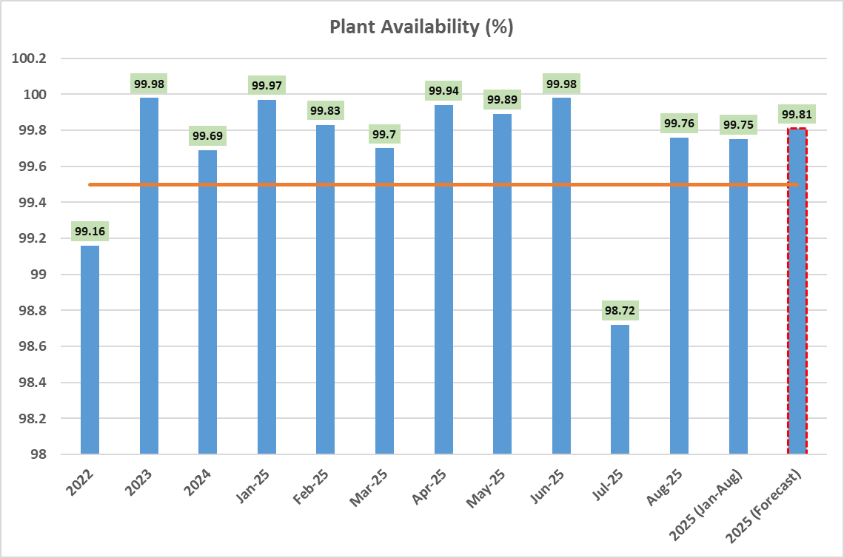
3.a. Plant Availability
Snapshot Plant Availability 2022, 2023, 2024 & 2025
Plant Availability:
The plant availability in 2022, 2023 and 2024 was 99.16%, 99.98 %, 99.69 %, respectively.
The Plant Availability for Q1 2025 was 99.83%, 0.17% lost due to 12 failure events.
The Plant Availability for Q2 2025 was 99.94%, 0.06% lost due to 9 failure events.
The Plant Availability for July and August was 98.72 and 99.76%, 0.24% lost due to 3 failure events and 2 load reduction events.
For the current year (until Aug 2025) the Plant availability is 99.75%. 0.25% of Plant availability was lost due to 26 failure events in Plant. Same is detailed in the Maintenance chapter (3.c).
If we do not have any failure till the month of Dec 2025 the forecasted availability for the year would have been 99.81%.

Slide 10
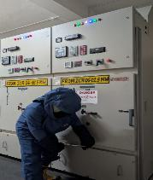
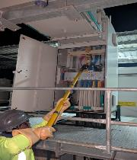
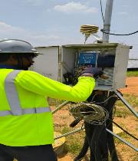
3.b. Maintenance activity cont…
The 2025 planned maintenance for the equipment’s were completed without any pending task as per the requirement of Original Equipment Manufacturer (OEM).
Description | Year 2025
 | Jan-25 | Feb-25 | Mar-25 | Apr-25 | May-25 | Jun-25 | Jul-25 | Aug-25 | Sep-25 | Oct-25 | Nov-25 | Dec-25 | Total | %age Achievement
Preventive Maintenance Plan for the Installed Equipment | 330 | 336 | 361 | 325 | 331 | 349 | 337 | 311 | 331 | 312 | 348 | 326 | 3997 | 67.05%
Preventive Maintenance completed for the Installed Equipment | 330 | 336 | 343 | 343 | 331 | 349 | 337 | 311 | - | - | - | - | 2680
Preventive Maintenance Delayed | - | - | 18 | - | - | - | - | - | - | - | - | -
Preventive Maintenance Not Done | - | - | - | - | - | - | - | - | - | - | - | - | -
Photographs- Panel maintenance and WMS maintenance

Slide 11
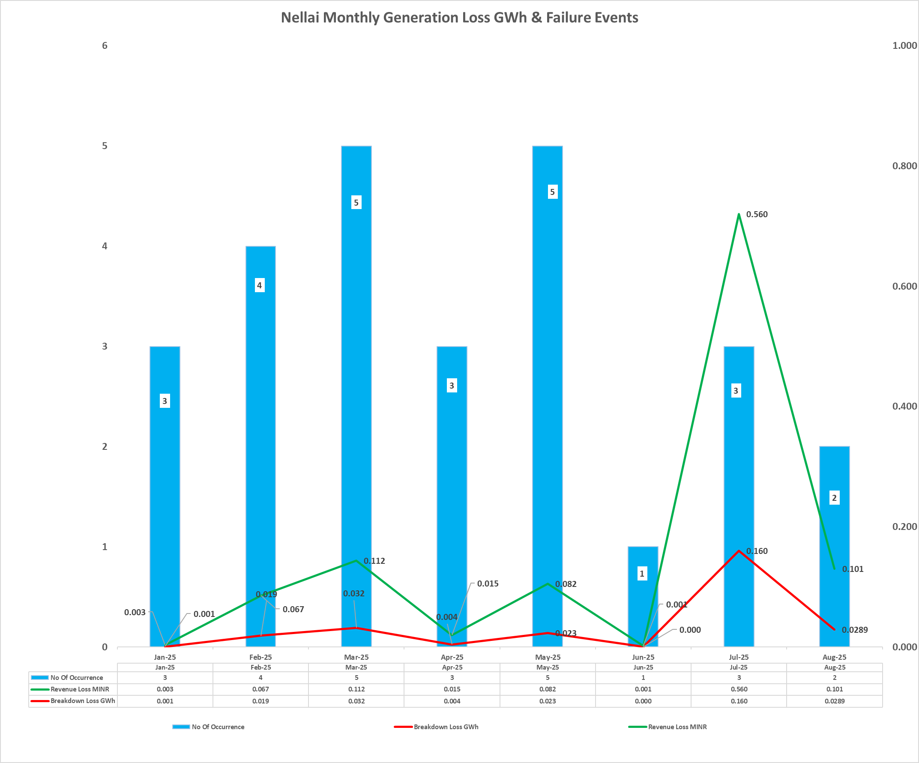
3.c. Breakdown details cont…
In month of January to August 2025, there was 26 tripping events (includes load reduction instruction from grid also) resulting in 0.32 GWh of generation loss, due to ACB flashover, inverters IGBT, control board and internal cable faults, and revenue loss of 1.13 MINR.

Slide 12
Agenda
Safety KPI- Nellai – Health, Safety and Security Summary
Operations Performance Overview.
2.a. Nellai Performance Snapshot for 2025
2.b. Nellai Performance snap from 2023 to 2025
Maintenance Performance Overview.
3.a. Plant availability.
3.b. Maintenance Activities.
3.c. Breakdown Insights.
Status of additional works
Action plan for Implementation of Nellai Improvement Observations & NRPL Site Observations Status
NRPL Site Observation Glimpse

Slide 13
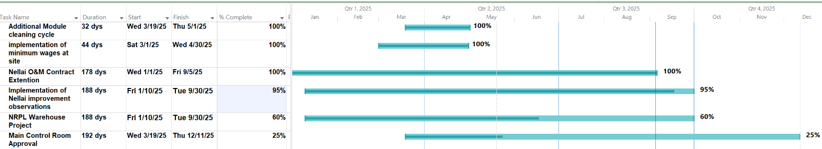
4.A. Action Plan for Implementation of Nellai Improvement Observations & NRPL Site Observations Status
For information
Summary Gantt chart for rectification against observations
Curve and Graph for completion of NRPL observation points
Sno. | Observation type | Total observation | Closed | Work in progress | Open Point
1 | HSS | 15 | 14 | 1 | 0
2 | Technical | 19 | 18 | 1 | 0
Total |  | 34 | 32 | 2 | 0
Above mentioned 32 completed improvements were done on FOC basis through efficient coordination with Essens.
The implementation of the Nellai improvement observation points is scheduled for completion by 30 Sep 2025.
Pending Improvement works as follow:
Fire Glass door for LV switchgear
Warehouse modification

Slide 14
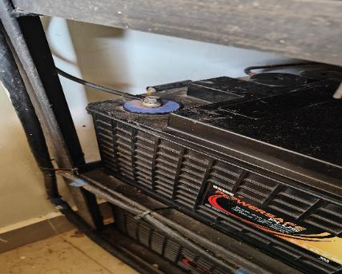
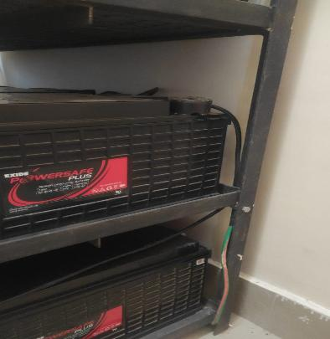
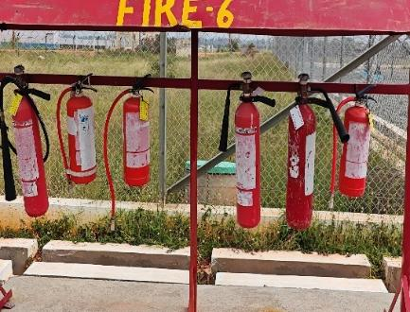
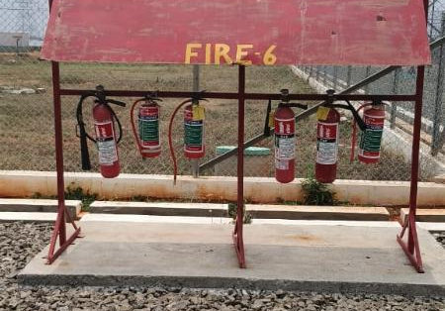
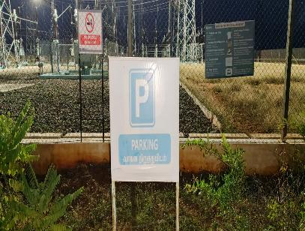
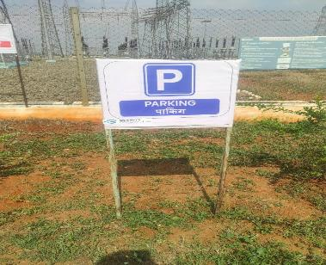
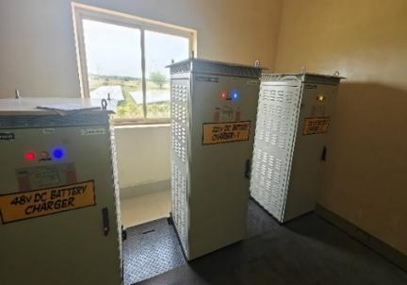
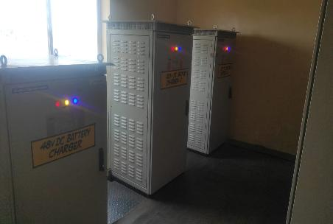
4.B. NRPL Site Observation glimpse
For information
Observation | Rectification
Exposed battery terminal at battery room-1 | Cover has been provided on battery terminal
Faded Sign board | New board provided
Observation | Rectification
Missing fire extinguisher nomenclature and upkeeping | Nomenclature and labels provided
Faulty indicator has been found on the panels of the DC battery charger | Faulty indicator rectification done

Slide 15
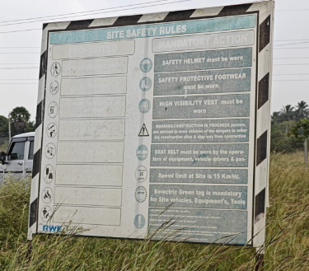
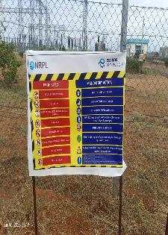
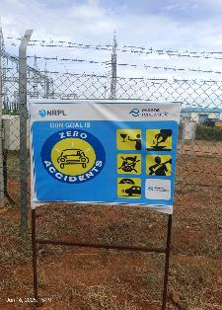
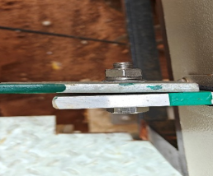
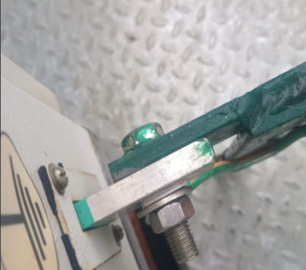
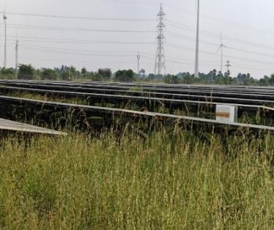
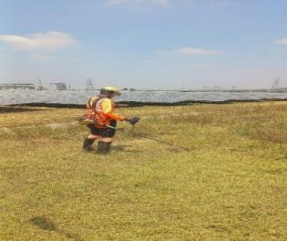
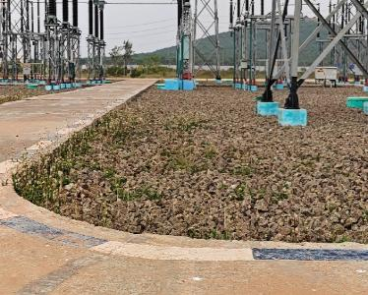
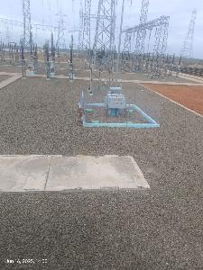
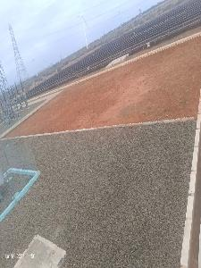
4.B. NRPL Site observations glimpse
For information
Observation | Rectification
Faded safety signage | Replacement of Faded safety signage at various locations
Tall grass in PV panel area. | Grass cutting done and continuous
Observation | Rectification
Improper jointing for conductors for panel earthing | Rectification of Improper jointing for conductors for panel earthing
Grass inside switchyard area | Removal of vegetation in switchyard

Slide 16
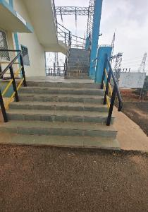
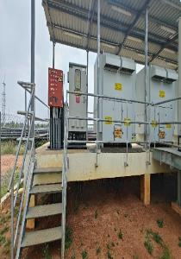
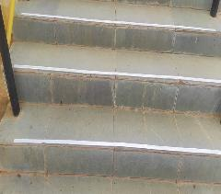
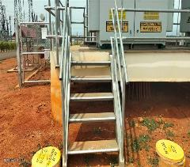
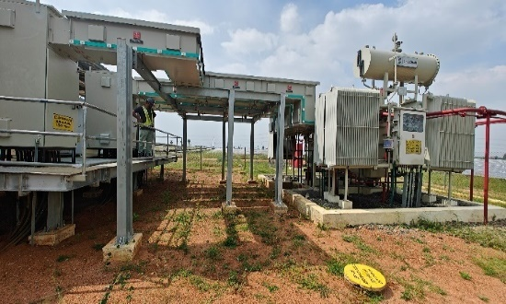
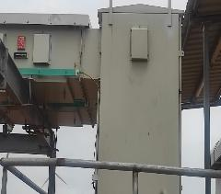
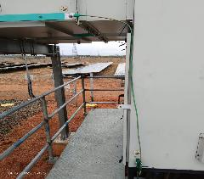
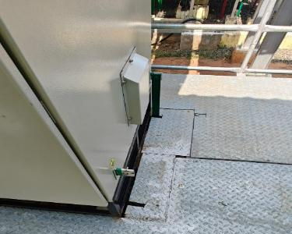
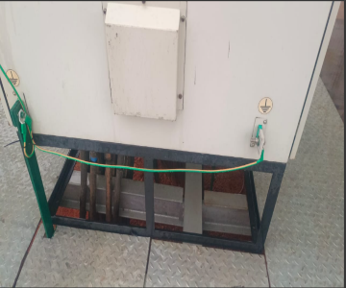
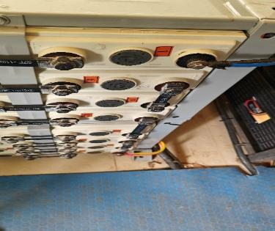
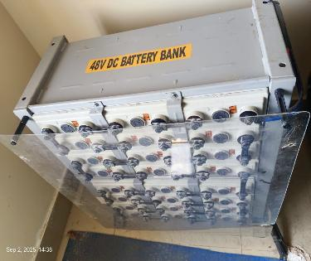
4.B. NRPL Site observations glimpse
For information
Observation | Rectification
Antiskid, night glowing tape not provided on stairs | Antiskid, night glowing tape on staircase at office cum control room and at inverter area
Double earthing of electrical equipment missing | Double earthing of electrical equipment
Observation | Rectification
Earthing required at busduct support structure | Earthing at busduct support structure
Exposed battery terminal at battery room-2 | Rectification of exposed battery terminal

Slide 17
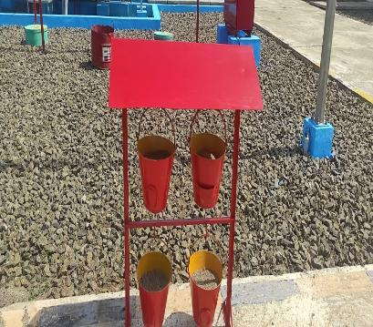
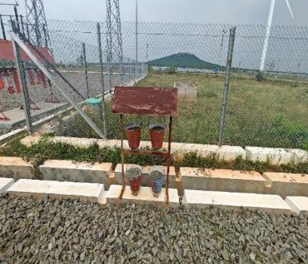
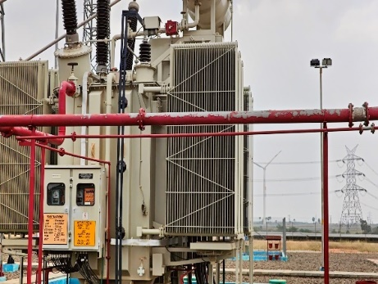
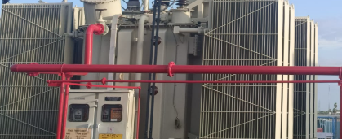
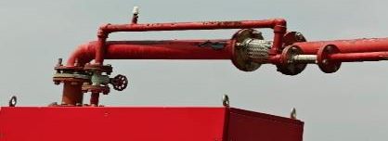
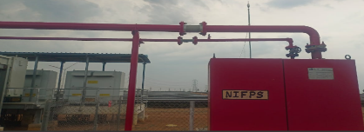
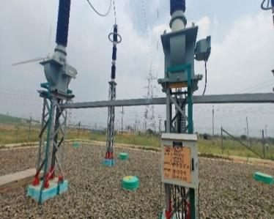
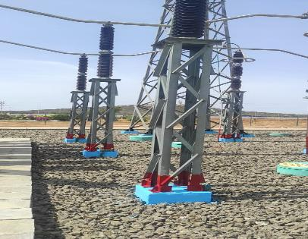
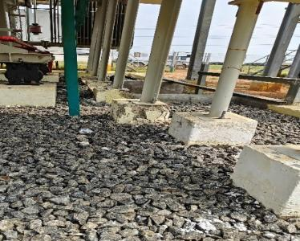
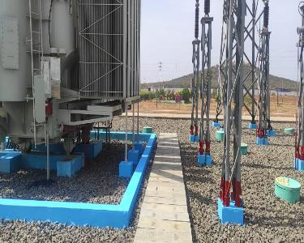
4.B. NRPL Site observations glimpse
For information
Observation | Rectification
Missing sand bucket nomenclature & upkeeping | Sand bucket nomenclature & upkeeping done
Color coding of switchyard bay phases | Color coding of switchyard bay phases
Observation | Rectification
Erosion of paint from surface of outdoor structures | Painting done for surface of outdoor structures
Damaged civil support foundation for main transformer | Rectification done for damaged civil support foundation for main transformer

